Slide 1
External Examiner Nomination
Online Process
Tips to manage the approvals section on Teams App
07/12/2023

Slide 2

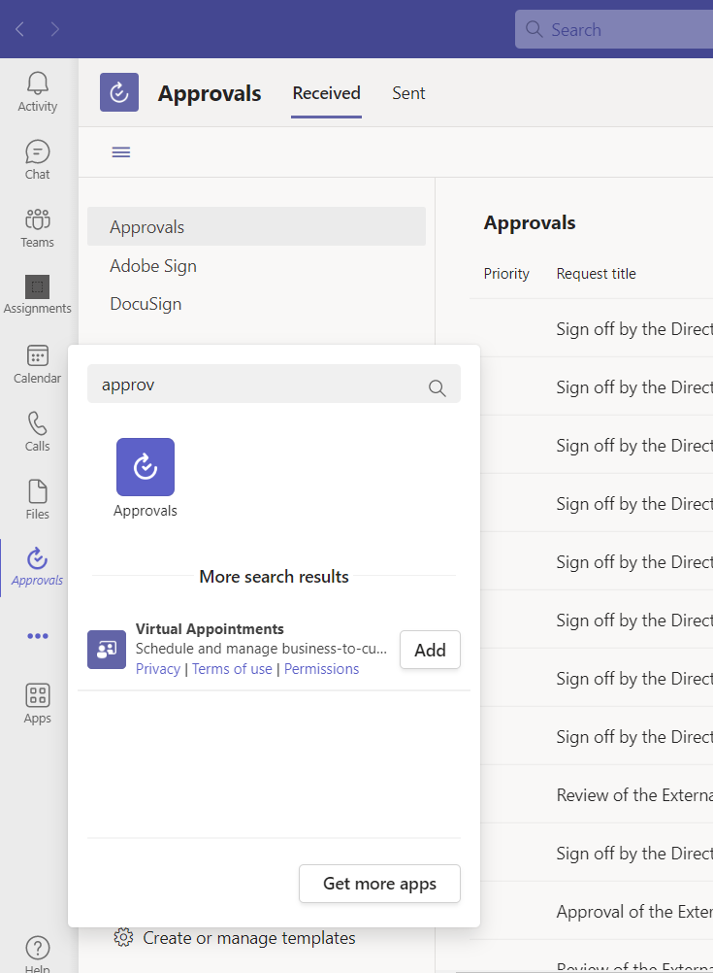
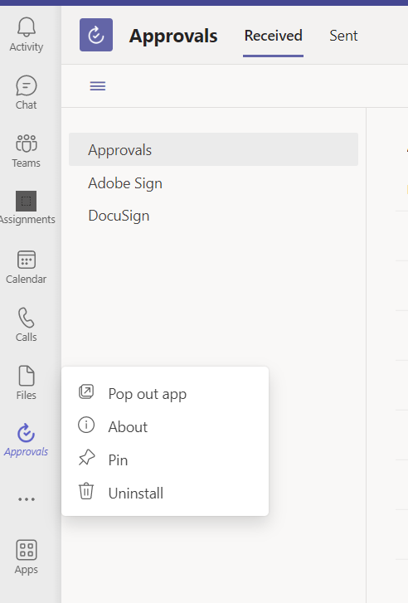
Tips to manage Approvals section on Teams
How to pin the Approvals section on your Teams App
To pin the approvals section in your Teams App, and have it visible, open your Teams App and go to the 3 dots shown at the bottom of the taskbar on the left side. In the search engine type "Approvals" and select the icon shown.
Once the Approval icon is displayed on your taskbar, do a right click with your mouse and select the "Pin" option to lock this section.
Step 02) Type “Approvals”
Step 03) Select this app
Step 05) Select the pin option
Step 01) 3 dots on the taskbar
Step 04) Right click on the Approval icon

Slide 3
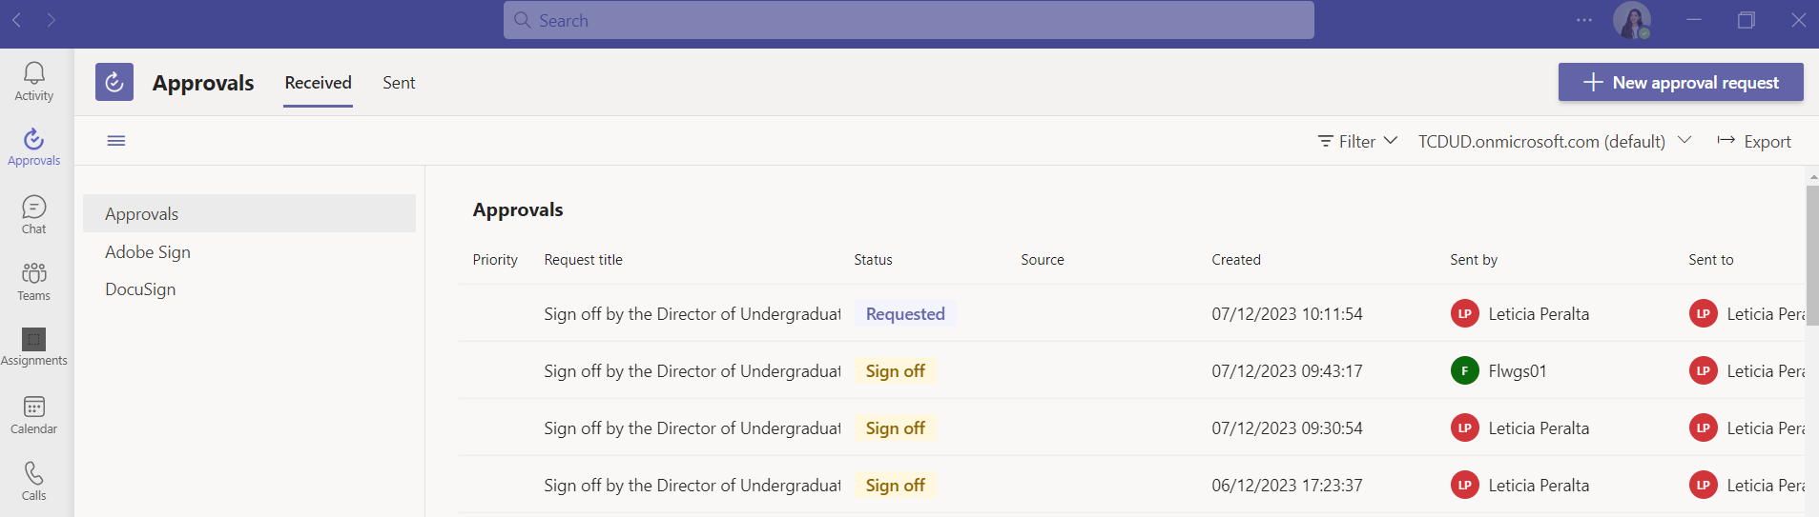
Tips to manage Approvals section on Teams
Managing all your approvals
Once you are on your approvals, make sure to click on the Received section to visualize all the approvals. A list of all the approvals will be shown on this section:
Click on the received section to display all the approvals you have received

Slide 4
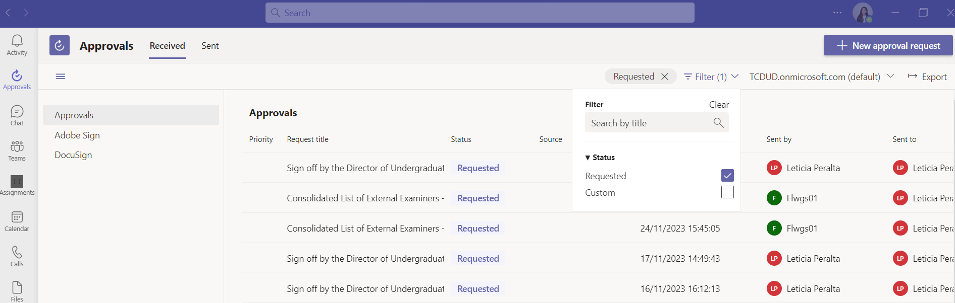
Tips to manage Approvals section on Teams
Managing all your approvals
To display only the approvals you have pending, click on the filter option and select the requested status.
Filter option
Click the “requested” option

